Slide 1

Week 2
Introduction to Java

Slide 2
Are you looking forward to anything this weekend?

Slide 3
Class content
Specific Java syntax
More on data types and variables
Introduction to functions

Slide 4
Syntax in Java
All code in Java must be inside a class
Java is case sensitive
File name has to match the class name
Only the code inside the main() method will be run
All identifiers must be unique

Slide 5
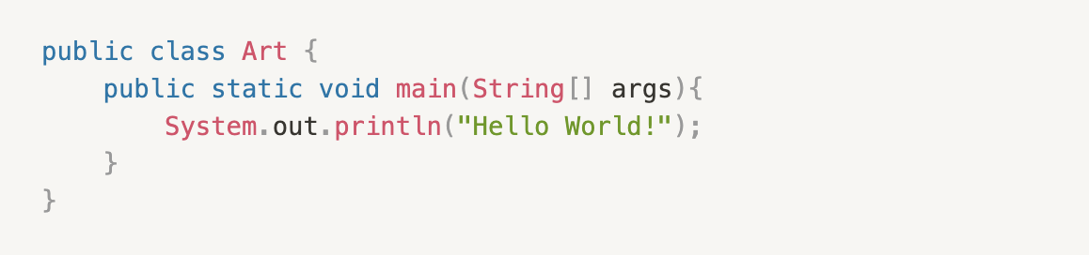
On statements
The begin and end for blocks of code are denoted by “{}”
Each statement in java must end with a “;”

Slide 6

Review
What are these names appropriate for?
smallCat
Cats
24dogs
Which one is a keyword?
void, hello, printed, lined

Slide 7
Review
How do you declare an integer variable with a value of 16?
How can you print the number 16? What about a string?
How do you print 16 along with the message “four squared is ” in front of it?

Slide 8
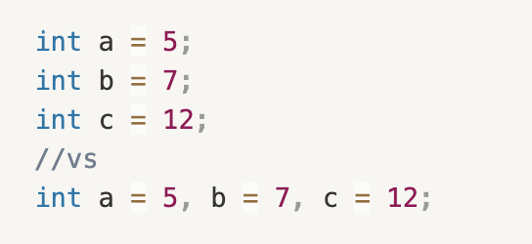
More on data types and variables…
You can actually declare multiple variables at once

Slide 9

Java numbers
Two types: integer types, floating point types
byte (-128 to 127)
short (-32768 to 32767)
int(-2147483648 to 2147483647)
Long (-9223372036854775808 to 9223372036854775807)
float, double

Slide 10
How are these numbers represented?
Through a base 2 number, or a binary code
0s and 1s
Base 2: 00110101
Base 10 (decimal): 53
0 * 128 + 0 * 64 + 1 * 32 + 1 * 16 + 0 * 8 + 1 * 4 + 0 * 2 + 1 * 1
128 | 64 | 32 | 16 | 8 | 4 | 2 | 1
0 | 0 | 1 | 1 | 0 | 1 | 0 | 1

Slide 11

Exercises
Translate these binary codes into decimal (base 10)
1011001
11110
1111
10000

Slide 12
Other data types
boolean
represented by true or false
character
char, a single character that is surrounded by single quotes
ASCII is also fair game

Slide 13
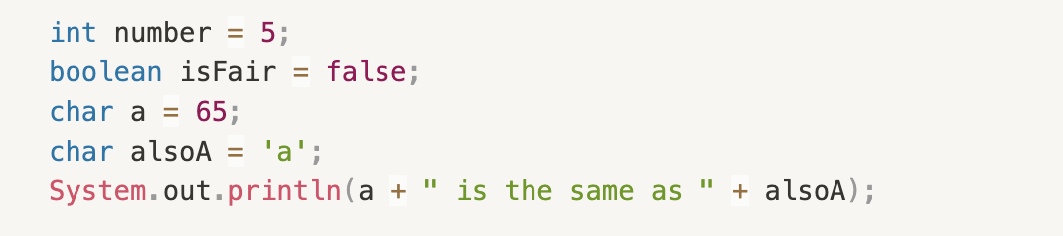
Example

Slide 14
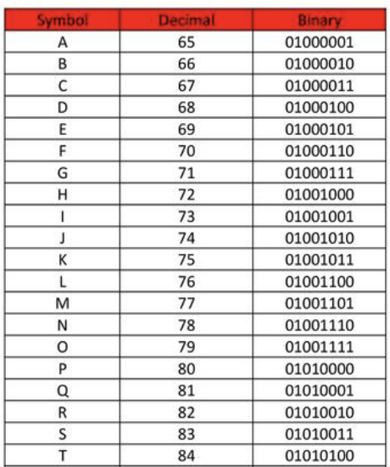
ASCII table

Slide 15

Functions and methods!
Basically the same thing
Contains blocks of code
Only runs when called
reusable

Slide 16
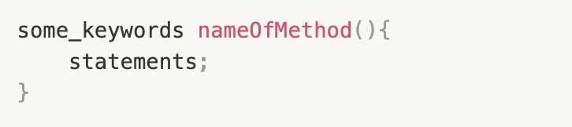
What do they look like?
We have already seen a function, does anyone know where?
The main() function
Here’s how to define (make) a method
They have to be created inside a class

Slide 17
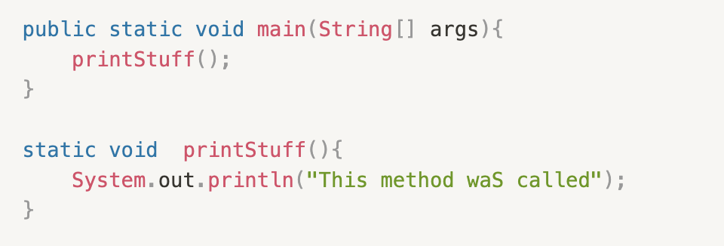
Example
Explained:
Static – means it belongs to this class, not an object of this class
Void – no return type
printStuff() is the name of the method, it is called in the main function to use the method
The code inside printStuff is run after the name is called
You can call multiple times

Slide 18
Practice!
Create your own method, with whatever name you want
Put “static void” before the method name
Have the method print out a few sentences about yourself
Call the method in the main() method so that you can run the program and test it

Slide 19

With variables
Variables only work inside the method if they are declared within the method
We will discuss “scope” a bit more
You can “pass” variables into the method
These are called parameters

Slide 20
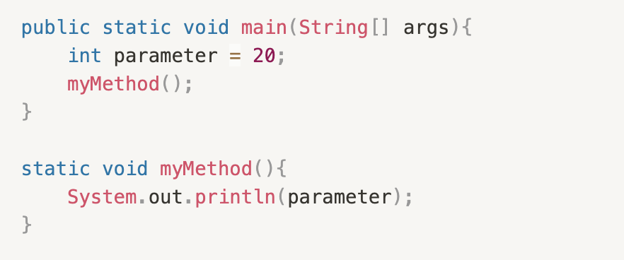
This code would give you an error
The code inside myMethod() does not know what parameter is
They are in two separate methods

Slide 21
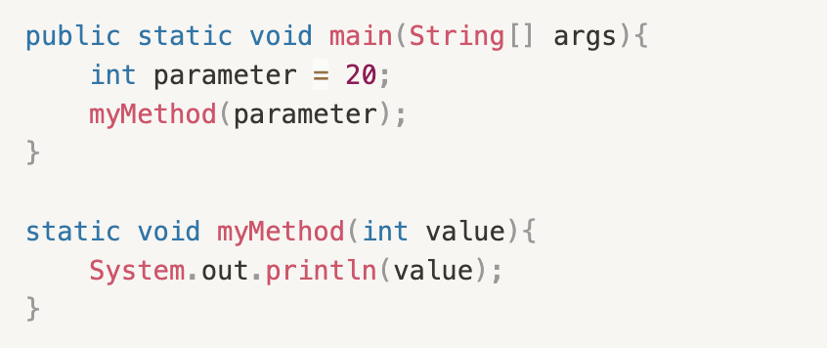
This would fix the issue
Be care – if you tried just calling myMethod(); instead of myMethod(int), it would give you an error
When calling a method, you have to give it all the parameters that it requires

Slide 22
Practice!
Create variables in the main() function for name, age, and favorite color
You will have to use different types
Pass them into a method that includes print statements which print the variables out for you, with some added text

Slide 23
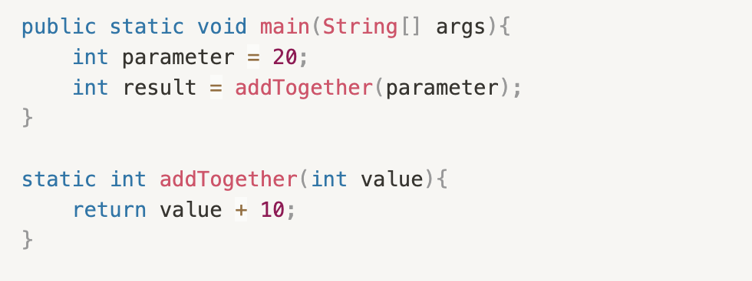
Return statements
The return type tells us what to “return”
Returning something simply means the method “giving” something back to the main method
A “void” method means you return nothing
You can also have “int”, “boolean”, “String” methods, etc.

